Slide 1
Analyzing the Relationship Between Athlete Participation & Medal Success at the 2021 Olympics
Akshat Saini
Lasell University
DAM II Foundations of Data Analytics II Darlington Sabasi
4/21/24

Slide 2
Background
Uncover the relationship between participating countries and their performance in international sporting events
Athlete participation influenced by factors like funding, interest in sports, & socioeconomic status
Goal: Determine if sending more athletes correlates with achieving more medals
Findings could influence countries to use more resources on sports

Slide 3
Hypothesis
Correlative Hypothesis: Is there a relationship between athlete participation and Total Olympic Medals?
Correlative Null Hypothesis: There is no relationship between athlete participation and Total Olympic Medals.
Correlative Alternative Hypothesis: There is a relationship between athlete participation and Total Olympic Medals.

Slide 4
Research Methodologies
IV: Total athletes participating per country
DV: Total medals won per country
Strong correlation between total athletes and total medals (r = 0.799) => Used correlation and regression testing to analyze the relationship
Explored GDP per Capita but found a weak correlation with total medals (r = 0.31)

Slide 5
Data Collection and Sampling
Used web-related data
Altered datasets to make it usable
Sample of 79 countries, total athletes, & total medals
Central Tendency, Correlation Testing, Regression Testing, & Bootstrap Model

Slide 6
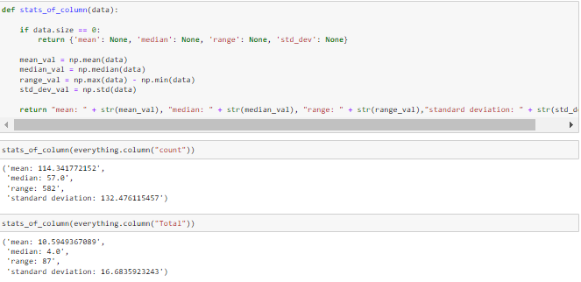
Data Overview:
Central Tendency

Slide 7
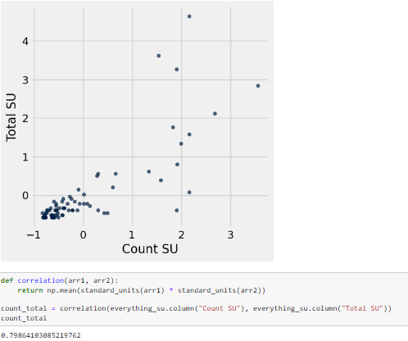
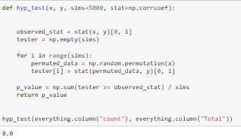
Data Overview:
Correlation Testing

Slide 8
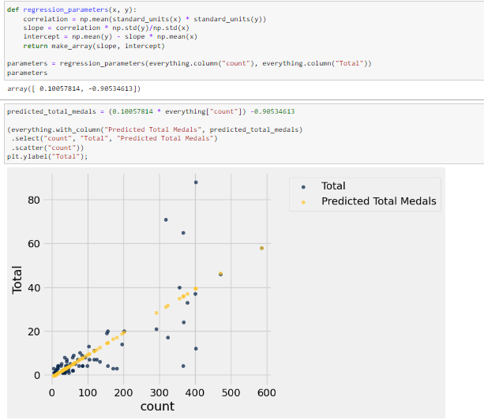
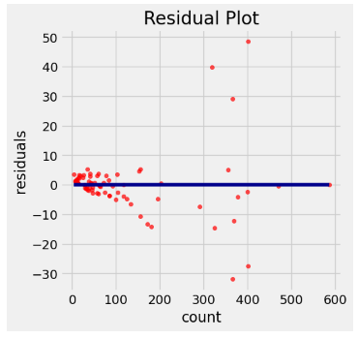
Data Overview: Regression Testing

Slide 9
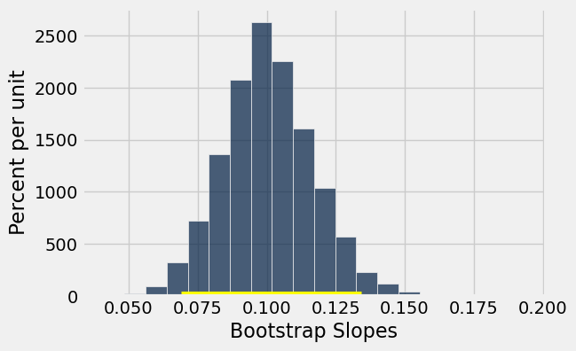

Data Overview: Bootstrap Testing

Slide 10
Hypothesis Testing
Hypothesis Test using r => P-Value = 0.0 < 0.05 => Reject the Null
Bootstrap Model => 0 is not in 95% confidence interval for the true slope of the regression line => Reject the Null

Slide 11
Interpretation of Results
Rejection of null hypothesis suggests a relationship between total athletes and total medals for a country.
Frequentist approach used due to fixed, non-random values of parameters
Correlation, regression, & confidence interval methods align with frequentist inferential statistics approach.

Slide 12
Conclusion
Strong, positive correlation between participating athletes & medals, supported by regression and hypothesis testing => low p-value => rejection of null hypothesis.
Increased participation can increase medal chances, interest in sports, open new economic avenues, & improve overall health indicators
Geography, socioeconomic status, and politics can influence medal counts. Population size and financial constraints may limit athlete participation.
Data limited to one event, necessitating further research

Slide 13
References
Adhikari, Adi, DeNero, J., & Wagner, D. (2022). Computational and inferential thinking: The Foundations of Data Science. Computational and Inferential Thinking: The Foundations of Data Science - Computational and Inferential Thinking. https://inferentialthinking.com/chapters/intro.html
The Beginner’s Guide to Statistical Analysis: 5 Steps & Examples. Scribbr. (2020). https://www.scribbr.com/category/statistics/
Kozyrkov, C. (2023, April 30). Statistics: Are you bayesian or frequentist?. Medium. https://towardsdatascience.com/statistics-are-you-bayesian-or-frequentist-4943f953f21b
Mehra, G. (2022, April 7). Hypothesis testing and confidence intervals using Python. Medium. https://medium.com/gaurang-portfolio/hypothesis-testing-and-confidence-intervals-using-python-a609dbfb5b12
Sarkhel, A. P. (2021, August 17). 2021 olympics in Tokyo. Kaggle. https://www.kaggle.com/datasets/arjunprasadsarkhel/2021-olympics-in-tokyo

